Slide 1
HITS Algorithm
Hubs and Authorities on the Internet

Slide 2
Meta-Search Engines
Search engine that passes query to several other search engines and integrate results.
Submit queries to host sites.
Parse resulting HTML pages to extract search results.
Integrate multiple rankings into a “consensus” ranking.
Present integrated results to user.
Examples:
Metacrawler
SavvySearch
Dogpile

Slide 3
HTML Structure & Feature Weighting
Weight tokens under particular HTML tags more heavily:
<TITLE> tokens (Google seems to like title matches)
<H1>,<H2>… tokens
<META> keyword tokens
Parse page into conceptual sections (e.g. navigation links vs. page content) and weight tokens differently based on section.

Slide 4
Bibliometrics: Citation Analysis
Many standard documents include bibliographies (or references), explicit citations to other previously published documents.
Using citations as links, standard corpora can be viewed as a graph.
The structure of this graph, independent of content, can provide interesting information about the similarity of documents and the structure of information.
CF corpus includes citation information.

Slide 5
Impact Factor
Developed by Garfield in 1972 to measure the importance (quality, influence) of scientific journals.
Measure of how often papers in the journal are cited by other scientists.
Computed and published annually by the Institute for Scientific Information (ISI).
The impact factor of a journal J in year Y is the average number of citations (from indexed documents published in year Y) to a paper published in J in year Y−1 or Y−2.
Does not account for the quality of the citing article.

Slide 6
Bibliographic Coupling
Measure of similarity of documents introduced by Kessler in 1963.
The bibliographic coupling of two documents A and B is the number of documents cited by both A and B.
Size of the intersection of their bibliographies.
Maybe want to normalize by size of bibliographies?
A
B

Slide 7
Co-Citation
An alternate citation-based measure of similarity introduced by Small in 1973.
Number of documents that cite both A and B.
Maybe want to normalize by total number of documents citing either A or B ?
A
B

Slide 8
Citations vs. Links
Web links are a bit different than citations:
Many links are navigational.
Many pages with high in-degree are portals not content providers.
Not all links are endorsements.
Company websites don’t point to their competitors.
Citations to relevant literature is enforced by peer-review.

Slide 9
HITS
In the same time that PageRank was being developed, Jon Kleinberg a professor in the Department of Computer Science at Cornell came up with his own solution to the Web Search problem.
He developed an algorithm that made use of the link structure of the web in order to discover and rank pages relevant for a particular topic. HITS (hyperlink-induced topic search) is now part of the Ask search engine (www.Ask.com).

Slide 10
Authorities
Authorities are pages that are recognized as providing significant, trustworthy, and useful information on a topic.
In-degree (number of pointers to a page) is one simple measure of authority.
However in-degree treats all links as equal.
Should links from pages that are themselves authoritative count more?
Page i is called an authority for the query "automobile makers" if it contains valuable information on the subject. Official web sites of car manufacturers, such as www.bmw.com, HyundaiUSA.com, www.mercedes-benz.com would be authorities for this search. Commercial web sites selling cars might be authorities on the subject as well. These are the ones truly relevant to the given query. These are the ones that the user expects back from the query engine.

Slide 11
Hubs
Hubs are index pages that provide lots of useful links to relevant content pages (topic authorities).
Their role is to advertise the authoritative pages. They contain useful links towards the authoritative pages. In other words, hubs point the search engine in the "right direction".
In real life, when you buy a car, you are more inclined to purchase it from a certain dealer that your friend recommends. Following the analogy, the authority in this case would be the car dealer, and the hub would be your friend. You trust your friend, therefore you trust what your friend recommends.
In the world wide web, hubs for our query about automobiles might be pages that contain rankings of the cars, blogs where people discuss about the cars that they purchased, and so on.

Slide 12
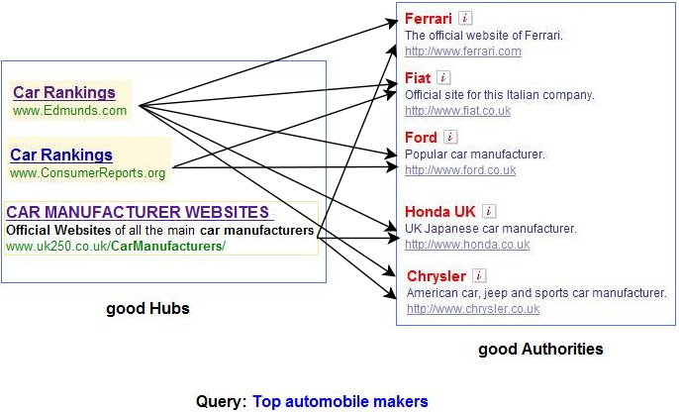

Slide 13
HITS
Algorithm developed by Kleinberg in 1998.
Attempts to computationally determine hubs and authorities on a particular topic through analysis of a relevant subgraph of the web.
Based on mutually recursive facts:
Hubs point to lots of authorities.
Authorities are pointed to by lots of hubs.

Slide 14
Hubs and Authorities
Together they tend to form a bipartite graph:
Hubs
Authorities

Slide 15
HITS Algorithm
Computes hubs and authorities for a particular topic specified by a normal query.
First determines a set of relevant pages for the query called the base set S.
Analyze the link structure of the web subgraph defined by S to find authority and hub pages in this set.

Slide 16
Constructing a Base Subgraph
For a specific query Q, let the set of documents returned by a standard search engine (e.g. VSR) be called the root set R.
Initialize S to R.
Add to S all pages pointed to by any page in R.
Add to S all pages that point to any page in R.
S
R

Slide 17
Base Limitations
To limit computational expense:
Limit number of root pages to the top 200 pages retrieved for the query.
Limit number of “back-pointer” pages to a random set of at most 50 pages returned by a “reverse link” query.
To eliminate purely navigational links:
Eliminate links between two pages on the same host.
To eliminate “non-authority-conveying” links:
Allow only m (m ≅ 4−8) pages from a given host as pointers to any individual page.

Slide 18
Authorities and In-Degree
Even within the base set S for a given query, the nodes with highest in-degree are not necessarily authorities (may just be generally popular pages like Yahoo or Amazon).
True authority pages are pointed to by a number of hubs (i.e. pages that point to lots of authorities).

Slide 19
Iterative Algorithm
Use an iterative algorithm to slowly converge on a mutually reinforcing set of hubs and authorities.
Maintain for each page p ∈ S:
Authority score: a_{p} (vector a)
Hub score: h_{p} (vector h)
Initialize all a_{p} = h_{p} = 1
Maintain normalized scores:

Slide 20
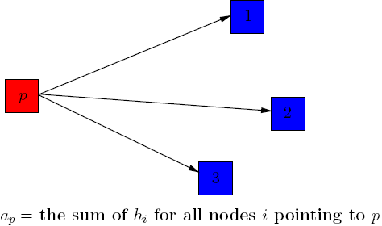
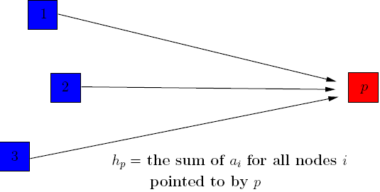
HITS Update Rules
Authorities are pointed to by lots of good hubs:
Hubs point to lots of good authorities:

Slide 21
Illustrated Update Rules
5
1
4
a₄ = h₁ + h₂ + h₃
h₄ = a₅ + a₆ + a₇
4
6
2
7
3

Slide 22
HITS Iterative Algorithm
Initialize for all p ∈ S: a_{p} = h_{p} = 1
For i = 1 to k:
For all p ∈ S: (update auth. scores)
For all p ∈ S: (update hub scores)
For all p ∈ S: a_{p}= a_{p}/c c:
For all p ∈ S: h_{p}= h_{p}/c c:
(normalize a)
(normalize h)

Slide 23
Convergence
Algorithm converges to a fix-point if iterated indefinitely.
Define A to be the adjacency matrix for the subgraph defined by S.
A_{ij} = 1 for i ∈ S, j ∈ S iff i→j
Authority vector, a, converges to the principal eigenvector of A^{T}A
Hub vector, h, converges to the principal eigenvector of AA^{T}
In practice, 20 iterations produces fairly stable results.

Slide 24
Results
Authorities for query: “Java”
java.sun.com
comp.lang.java FAQ
Authorities for query “search engine”
Yahoo.com
Excite.com
Lycos.com
Altavista.com
Authorities for query “Gates”
Microsoft.com
roadahead.com

Slide 25
Result Comments
In most cases, the final authorities were not in the initial root set generated using Altavista.
Authorities were brought in from linked and reverse-linked pages and then HITS computed their high authority score.

Slide 26
Finding Similar Pages Using Link Structure
Given a page, P, let R (the root set) be t (e.g. 200) pages that point to P.
Grow a base set S from R.
Run HITS on S.
Return the best authorities in S as the best similar-pages for P.
Finds authorities in the “link neighbor-hood” of P.

Slide 27
Similar Page Results
Given “honda.com”
toyota.com
ford.com
bmwusa.com
saturncars.com
nissanmotors.com
audi.com
volvocars.com

Slide 28
HITS for Clustering
An ambiguous query can result in the principal eigenvector only covering one of the possible meanings.
Non-principal eigenvectors may contain hubs & authorities for other meanings.
Example: “jaguar”:
Atari video game (principal eigenvector)
NFL Football team (2nd non-princ. eigenvector)
Automobile (3rd non-princ. eigenvector)

Slide 29
PageRank
Alternative link-analysis method used by Google (Brin & Page, 1998).
Does not attempt to capture the distinction between hubs and authorities.
Ranks pages just by authority.
Applied to the entire web rather than a local neighborhood of pages surrounding the results of a query.

Slide 30
HITS Example
http://www.math.cornell.edu/~mec/Winter2009/RalucaRemus/Lecture4/lecture4.html

Slide 31
A Simple Example
Update Authority Scores first
1.000
1.000
1.000
1.000
1.000
1.000
1.000
1.000
Auth
1.000
1.000
Key:
Hub

Slide 32
A Simple Example
Update Authority Scores first, using Hub scores
One incoming edge
1.000
1.000
1.000
1.000
1.000
1.000
1.000
1.000
Auth
1.000
1.000
Key:
Hub

Slide 33
A Simple Example
Update Authority Scores first
1.000
1.000
1.000
1.000
1.000
1.000
1.000
1.000
Auth
1.000
1.000
Key:
Hub

Slide 34
A Simple Example
Update Authority Scores first
1.000
1.000
1.000
1.000
1.000
1.000
1.000
1.000
Auth
1.000
1.000
Key:
Hub

Slide 35
A Simple Example
Update Authority Scores first
Three incoming edges
1.000
1.000
1.000
1.000
1.000
1.000
1.000
1.000
Auth
1.000
1.000
Key:
Hub

Slide 36
A Simple Example
Update Authority Scores first
Three incoming edges
1.000
3.000
1.000
1.000
1.000
1.000
1.000
1.000
Auth
1.000
1.000
Key:
Hub

Slide 37
A Simple Example
Update Authority Scores first
One incoming edge
1.000
3.000
1.000
1.000
1.000
1.000
1.000
1.000
Auth
1.000
1.000
Key:
Hub

Slide 38
A Simple Example
Update Authority Scores first
1.000
3.000
1.000
1.000
1.000
1.000
1.000
1.000
Auth
1.000
1.000
Key:
Hub

Slide 39
A Simple Example
Update Authority Scores first
1.000
3.000
1.000
1.000
1.000
1.000
1.000
1.000
Auth
1.000
1.000
Key:
Hub

Slide 40
A Simple Example
Update Authority Scores first
1.000
3.000
1.000
1.000
1.000
1.000
1.000
1.000
Auth
1.000
1.000
Key:
Hub
No Incoming Edges

Slide 41
A Simple Example
Update Authority Scores first
1.000
3.000
1.000
1.000
1.000
1.000
0.000
1.000
Auth
1.000
1.000
Key:
Hub

Slide 42
A Simple Example
Update Authority Scores first
1.000
3.000
1.000
1.000
1.000
1.000
0.000
1.000
Auth
1.000
1.000
Key:
Hub
Two incoming edges

Slide 43
A Simple Example
Update Authority Scores first
1.000
3.000
1.000
1.000
1.000
1.000
0.000
2.000
Auth
1.000
1.000
Key:
Hub

Slide 44
A Simple Example
Update Hub Scores using new Authority Scores
1.000
3.000
1.000
1.000
1.000
1.000
0.000
2.000
Auth
1.000
1.000
Key:
Hub

Slide 45
A Simple Example
Update Hub Scores using new Authority Scores
1.000
3.000
1.000
3.000
1.000
1.000
0.000
2.000
Auth
1.000
1.000
Key:
Hub

Slide 46
A Simple Example
Update Hub Scores using new Authority Scores
1.000
3.000
1.000
3.000
1.000
1.000
0.000
2.000
Auth
1.000
1.000
Key:
Hub

Slide 47
A Simple Example
Update Hub Scores using new Authority Scores
1.000
3.000
1.000
3.000
1.000
1.000
0.000
2.000
Auth
1.000
1.000
Key:
Hub

Slide 48
A Simple Example
Update Hub Scores using new Authority Scores
1.000
3.000
1.000
3.000
1.000
1.000
0.000
2.000
Auth
1.000
1.000
Key:
Hub

Slide 49
A Simple Example
Update Hub Scores using new Authority Scores
1.000
3.000
1.000
3.000
1.000
2.000
0.000
2.000
Auth
1.000
1.000
Key:
Hub

Slide 50
A Simple Example
Update Hub Scores using new Authority Scores
1.000
3.000
1.000
3.000
1.000
2.000
0.000
2.000
Auth
1.000
1.000
Key:
Hub

Slide 51
A Simple Example
Update Hub Scores using new Authority Scores
1.000
3.000
1.000
3.000
1.000
2.000
0.000
2.000
Auth
6.000
1.000
Key:
Hub

Slide 52
A Simple Example
Update Hub Scores using new Authority Scores
1.000
3.000
1.000
3.000
1.000
2.000
0.000
2.000
Auth
6.000
1.000
Key:
Hub

Slide 53
A Simple Example
1.000
3.000
1.000
3.000
1.000
2.000
0.000
2.000
Auth
6.000
3.000
Key:
Hub

Slide 54
A Simple Example
1.000
3.000
1.000
3.000
1.000
2.000
0.000
2.000
Auth
6.000
3.000
Key:
Hub
Sum of Squares: 15.000

Slide 55
A Simple Example
0.258
0.775
0.258
3.000
1.000
2.000
0.000
0.516
Auth
6.000
3.000
Key:
Hub
Divide By: 3.873 (sqrt(15))

Slide 56
A Simple Example
0.258
0.775
0.258
3.000
1.000
2.000
0.000
0.516
Auth
6.000
3.000
Key:
Hub
Sum of Squares: 59

Slide 57
A Simple Example
0.258
0.775
0.258
0.391
0.130
0.260
0.000
0.516
Auth
0.781
0.391
Key:
Hub
Divide By: 7.681 (sqrt(59))

Slide 58
A Simple Example
0.258
0.775
0.258
0.391
0.130
0.260
0.000
0.516
Auth
0.781
0.391
Key:
Hub
After First Iteration

Slide 59
A Simple Example
0.383
0.767
0.064
0.374
0.031
0.249
0.000
0.511
Auth
0.811
0.374
Key:
Hub
After Second Iteration

Slide 60
A Simple Example
0.395
0.760
0.015
0.370
0.007
0.252
0.000
0.517
Auth
0.814
0.370
Key:
Hub
After Third Iteration

